Slide 1

Chronic Kidney Disease Analysis Using IBM Watson Machine Learning Service
TEAM 11
DEV SINGH
P. YASH REDDY
AKSHAT BHARDWAJ
RISHITA SRIVASTAVA

Slide 2
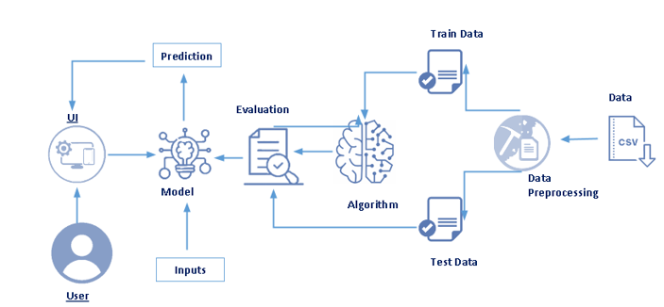
INTRODUCTION
Chronic Kidney Disease (CKD) is a major medical problem and can be cured if treated in the early stages. We have built a model using various concepts of machine learning such as supervised and unsupervised learning, logistic regression and many more to help patients identify this problem and start their medication at the early stage.
We have designed a web app using Flask which will take the inputs and predict whether the user is suffering from CKD or not. Below is a flowchart depicting our project.

Slide 3

modules
Creating Dataset
Data Preprocessing
Website
Training the model on IBM

Slide 4
METHODOLOGY
There are several Machine learning algorithms to be used depending on the data you are going to process such as images, sound, text, and numerical values. The algorithms that you can choose according to the objective that you might have it may be Classification algorithms or Regression algorithms.
Example: 1. Linear Regression.
2. Logistic Regression.
3. Random Forest Regression / Classification.
4. Decision Tree Regression / Classification.
As the prediction for model is classification type, we apply a logistic regression algorithm on our dataset.
Logistic regression is the appropriate regression analysis to conduct when the dependent variable is binary. Like all regression analyses, the logistic regression is a predictive analysis. Logistic regression is used to describe data and to explain the relationship between one dependent binary variable and one or more nominal, ordinal, interval or ratio-level independent variables.

Slide 5
Module Description
Our project consists of the following modules:
Creating dataset: We have created our dataset which consists of the fields like- age, uric level, etc. We have used this dataset to train our model and derive the required results.
Data Preprocessing: In this stage we have eliminated the columns which are not important for our prediction model. We have find the null values and other details of the dataset.
Application building: In this module we have created a website which consists of home page and result page. The home page consists of a button which will take the user to another page where his details are asked. Based on these inputs our model will predict the results which will be displayed on the next page.
Training the model on IBM cloud: Lastly, we have deployed our Machine Learning Model on IBM Cloud.

Slide 6

Thank You!

